Slide 1


Boston Housing Dataset Analysis
1. Shreeyash Lahane (NUID 002743020)
2. Ram Vaghani (NUID 002704237)
3. Tripti Gupta (NUID 002776822)
4. Ikra Bhagwan (NUID 002794307)

Slide 2
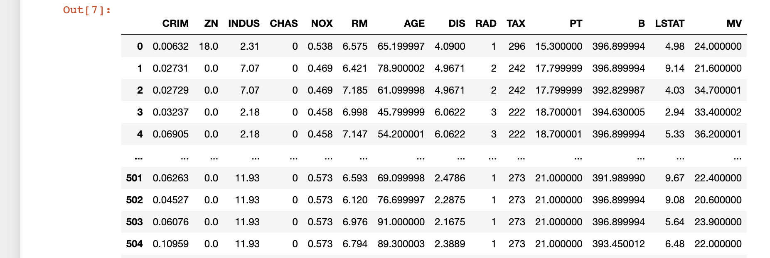
Data
The Boston Housing dataset is a commonly used dataset in machine learning for regression problems. It consists of 506 samples, with each sample representing a suburb of Boston. Each sample has 13 features which can be used to predict the median value (in thousands of dollars) of owner-occupied homes in the suburb.

Slide 3
Models
Linear Regression | Decision Tree | Random Forest
Purpose: Predict numeric values based on linear relationships between variables. Strengths: Simple, interpretable, fast. Limitations: Assumes linear relationships, sensitive to outliers, might not capture complex patterns. Applicability: Well-suited for tasks like predicting sales figures, stock prices, or temperature. Quick Insights: Helps identify which features are most influential in the prediction. | Purpose: Make decisions by asking feature-based questions. Strengths: Handles both data types, captures nonlinear patterns, easy to understand. Limitations: Prone to overfitting, sensitive to data variations, can lack generalization. Flexibility: Can handle mixed data types (categorical and numerical). Visual Interpretation: Trees can be graphically visualized to understand the decision-making process. | Purpose: Improve predictions by combining multiple decision trees. Strengths: Reduces overfitting, works with high-dimensional data, provides feature importance. Limitations: Computationally intensive, less interpretable than a single tree, can struggle with imbalanced data. Diversity: Trees are trained on random subsets of data and features, reducing overfitting.

Slide 4
Additional Approach
We experimented with advanced regression techniques neural networks to potentially improve the predictive performance. We found that neural networks outperformed linear regression and decision trees, but it was not able to outperform random forests. Few possible explanations for this finding are:
Neural networks are more complex models than decision trees and random forests. This means that they require more data to train, and they are more prone to overfitting.
Neural networks are not as interpretable as decision trees and random forests. This can make it difficult to understand how the model is making its predictions, thus it will be difficult to have guidance on how to help it.
Hyperparameter tuning on Random Forest: Performed an extensive hyperparameter tuning process for a Random Forest model on the Boston Housing Dataset. Implemented GridSearchCV to optimize parameters. This is in-depth analysis aimed to enhance model accuracy and generalization, demonstrating a comprehensive approach beyond the baseline requirements.

Slide 5
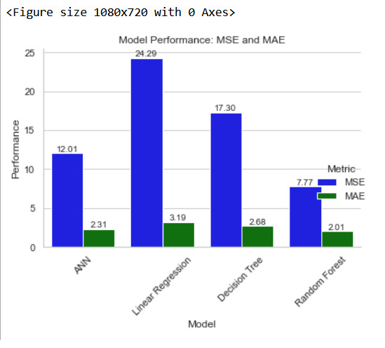
Results
Model | Mse | Mae
ANN | 12.01 | 2.31
Linear Regression | 24.29 | 3.19
Decision Tree | 17.30 | 2.68
Random Forest | 7.77 | 2.01

Slide 6
Future Research Opportunities:
Feature Engineering Potential: The potential of enhancing model accuracy lies in feature engineering. By introducing new features, you can uncover valuable insights. For instance, consider crafting features that encompass variables like proximity to significant urban landmarks, accessibility to public transportation, or measures of neighborhood walkability.
Exploring Diverse Data Splits: The exploration of diverse data splitting methodologies can shed light on your model's performance. Techniques such as cross-validation, temporal splits, or stratified sampling can offer varying perspectives on your model's generalizability and effectiveness.
Bayesian Regression Exploration: Delving into Bayesian regression techniques offers more than just point predictions. It equips you with the ability to quantify prediction uncertainty. This aspect becomes especially pertinent in domains like real estate forecasting, where grasping the level of prediction uncertainty holds significant value.

